Slide 1
Data Science Basics in R:
Day 3: Exploratory data analysis

Slide 2
Goals for today
Define descriptive statistics & exploratory data analysis
Create your first data visualization in R
Identify options for visualization in R, including ggplot2
Great creative and have fun exploring datasets

Slide 3
Descriptive statistics

Slide 4
Descriptive statistics
Descriptive statistics summarize data, and typically describe three types of things:
center (e.g., mean, median)
spread (e.g., standard deviation, interquartile range)
counts & rates (e.g., summary tables)

Slide 5
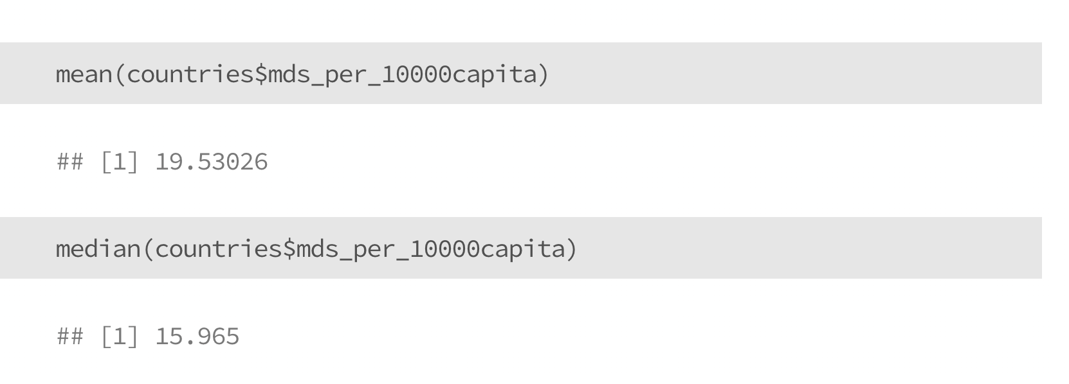
Descriptive statistics
Measures of centrality

Slide 6
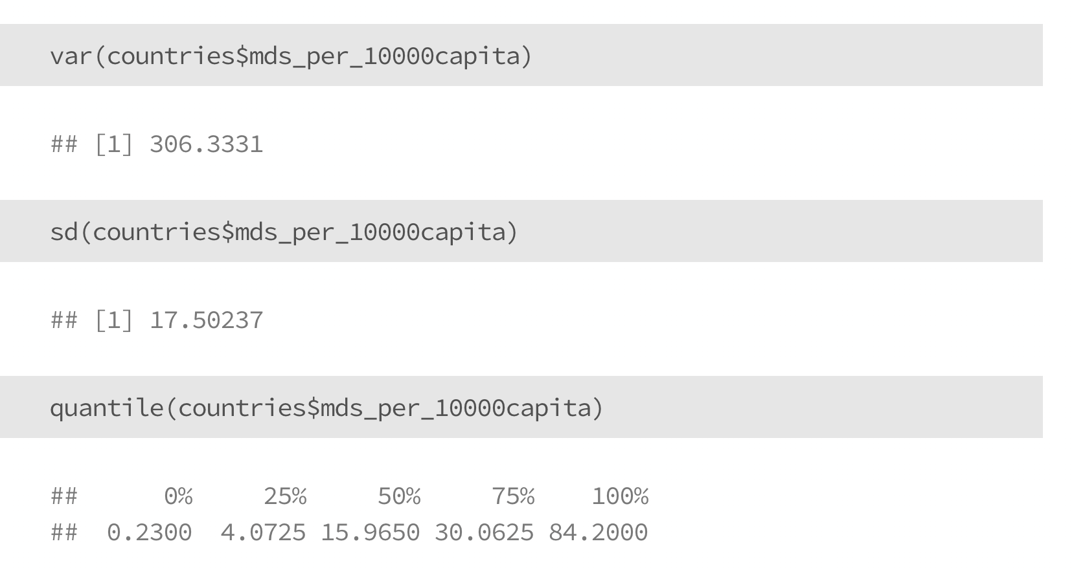
Descriptive statistics
Measures of spread

Slide 7
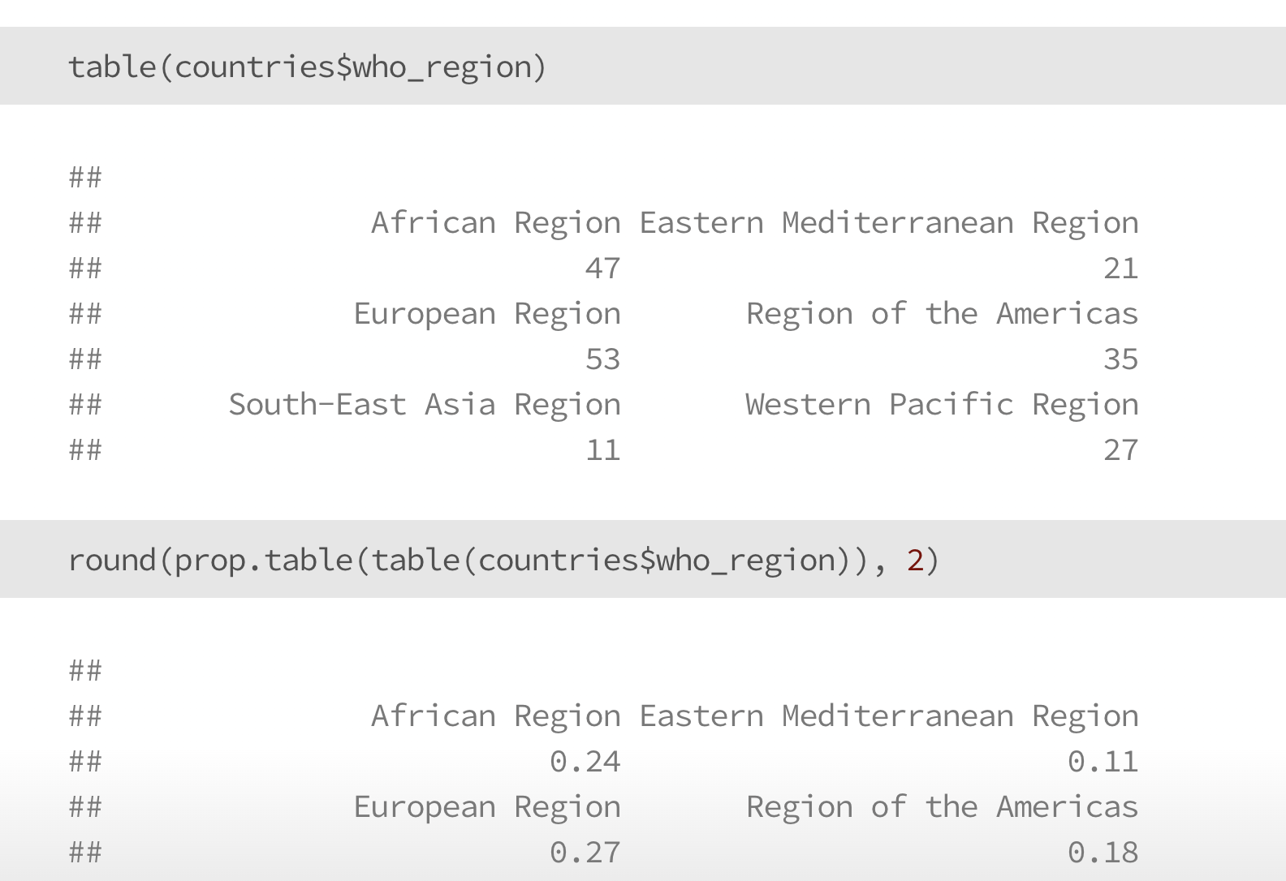
Descriptive statistics
Counts and rates

Slide 8
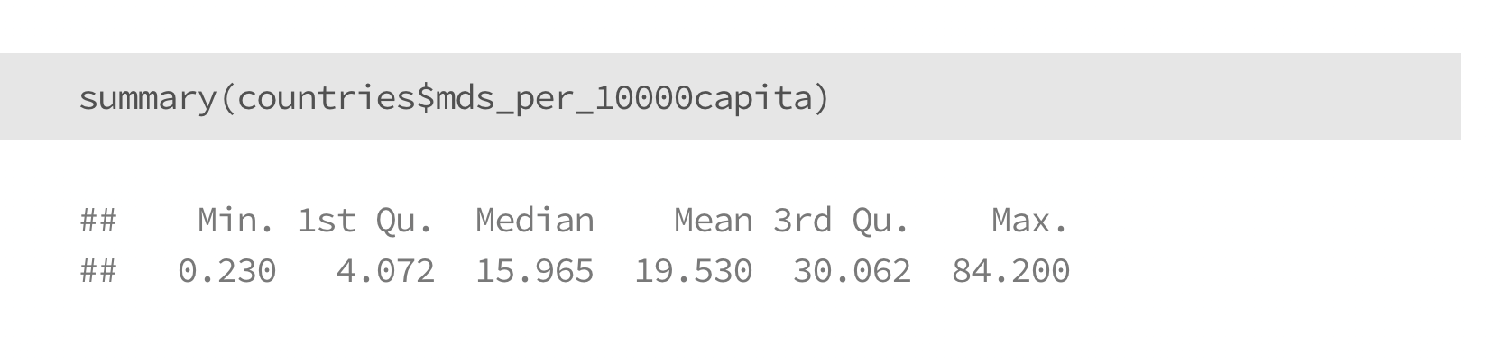
Basic data summarization

Slide 9
Data visualization

Slide 10
Data visualization
Data visualization is one of the major parts of any exploratory analysis, it’s easier to identify trends visually than by staring at raw data or summary tables

Slide 11
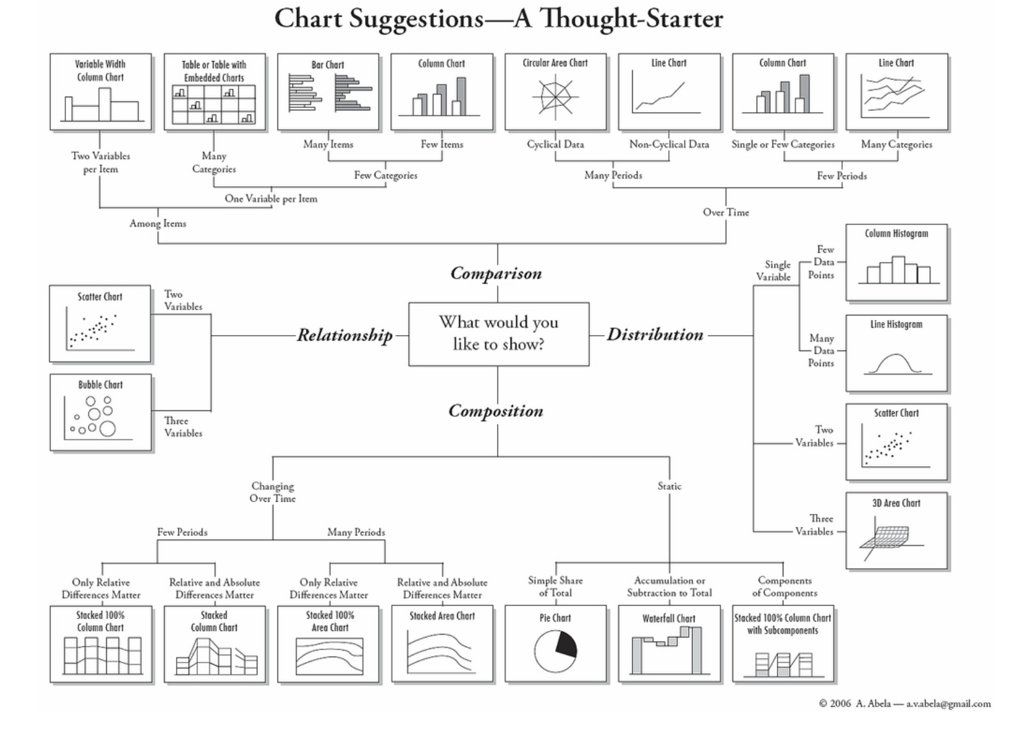
What are you trying to learn?
Graphic by Andrew Abela
https://extremepresentation.typepad.com/blog/2006/09/choosing_a_good.html

Slide 12
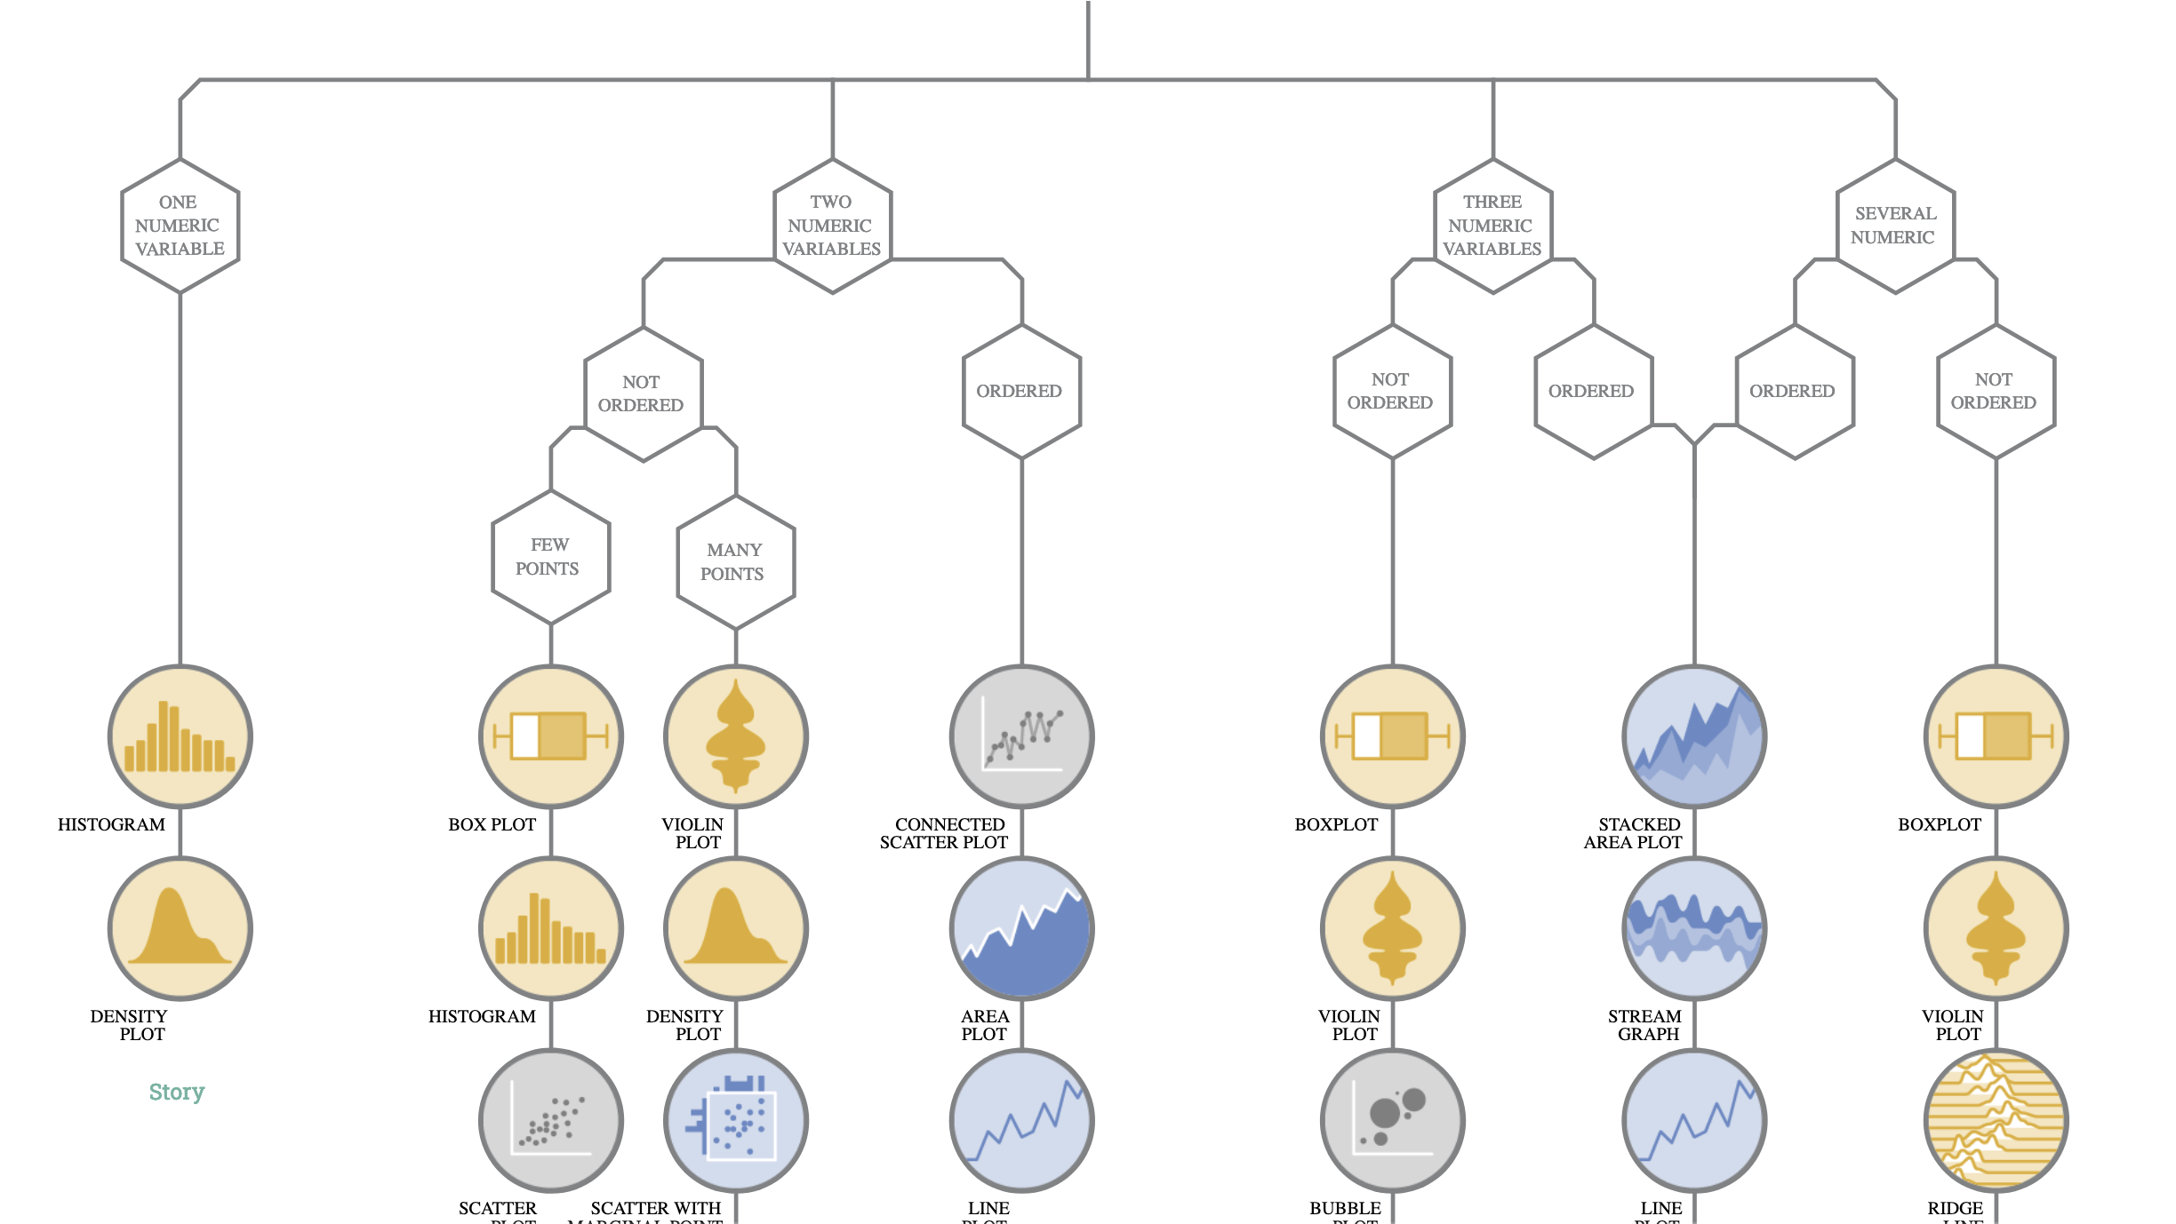
What are you trying to learn?
Graphic by Data to Viz
https://www.data-to-viz.com/

Slide 13
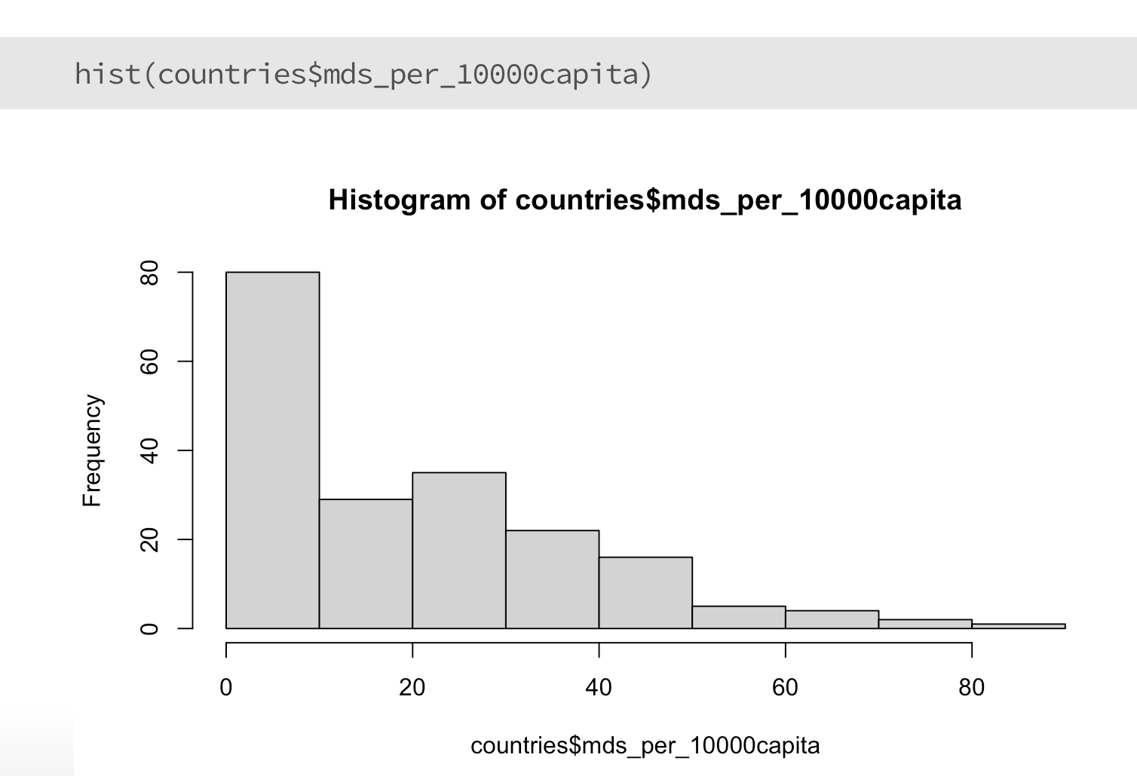
Basic plots in R
histogram

Slide 14
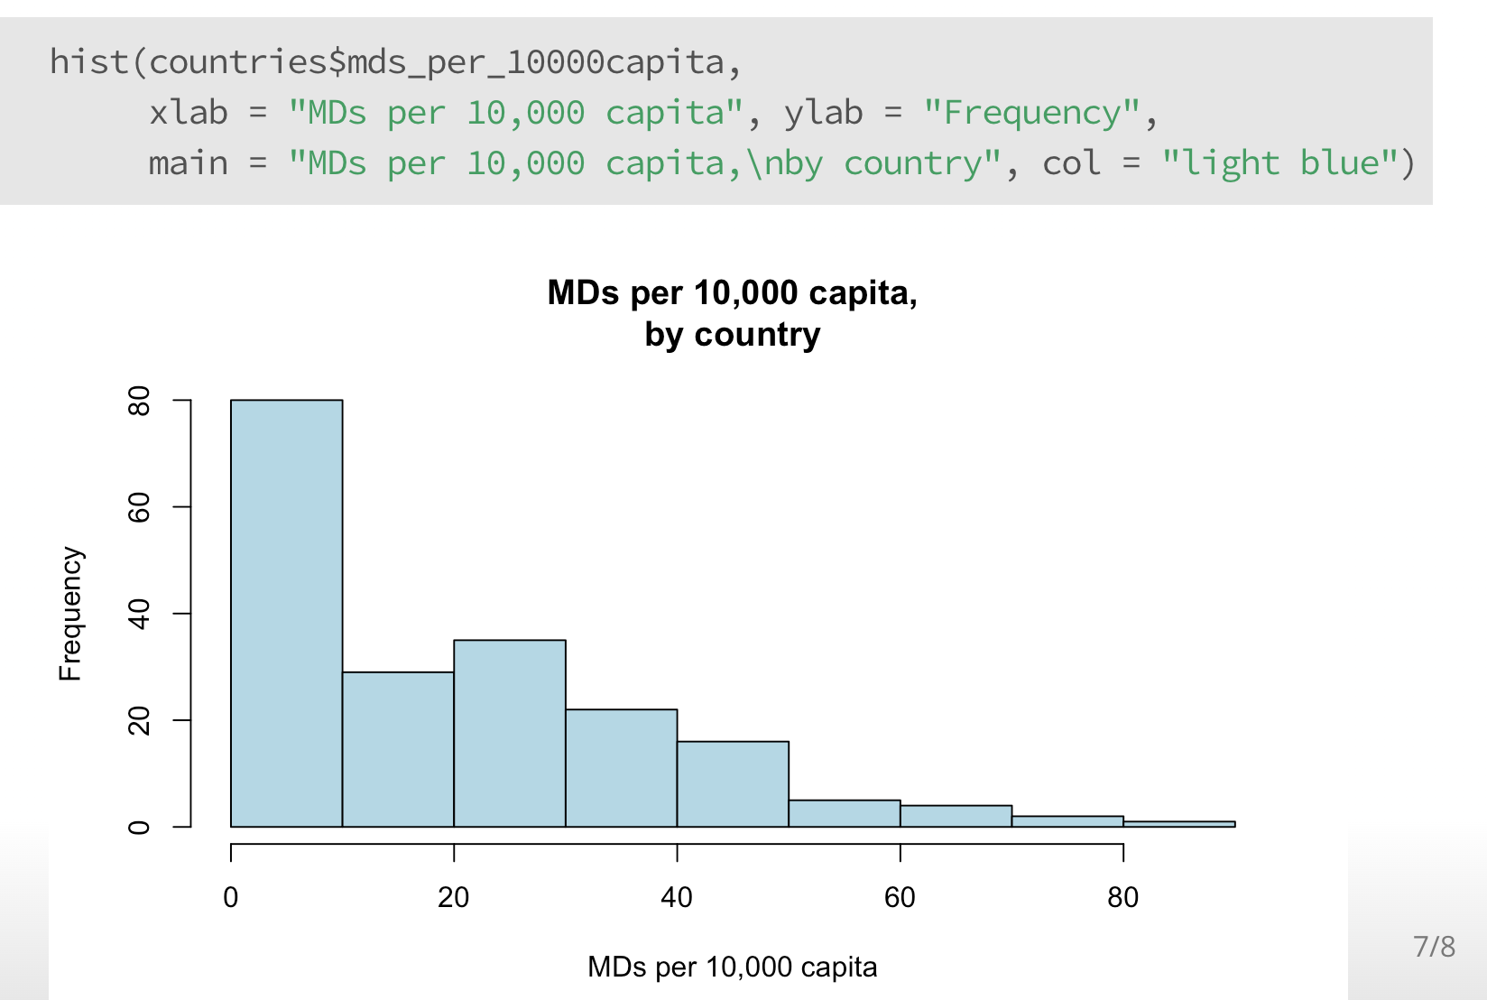
Basic plots in R
labeling

Slide 15
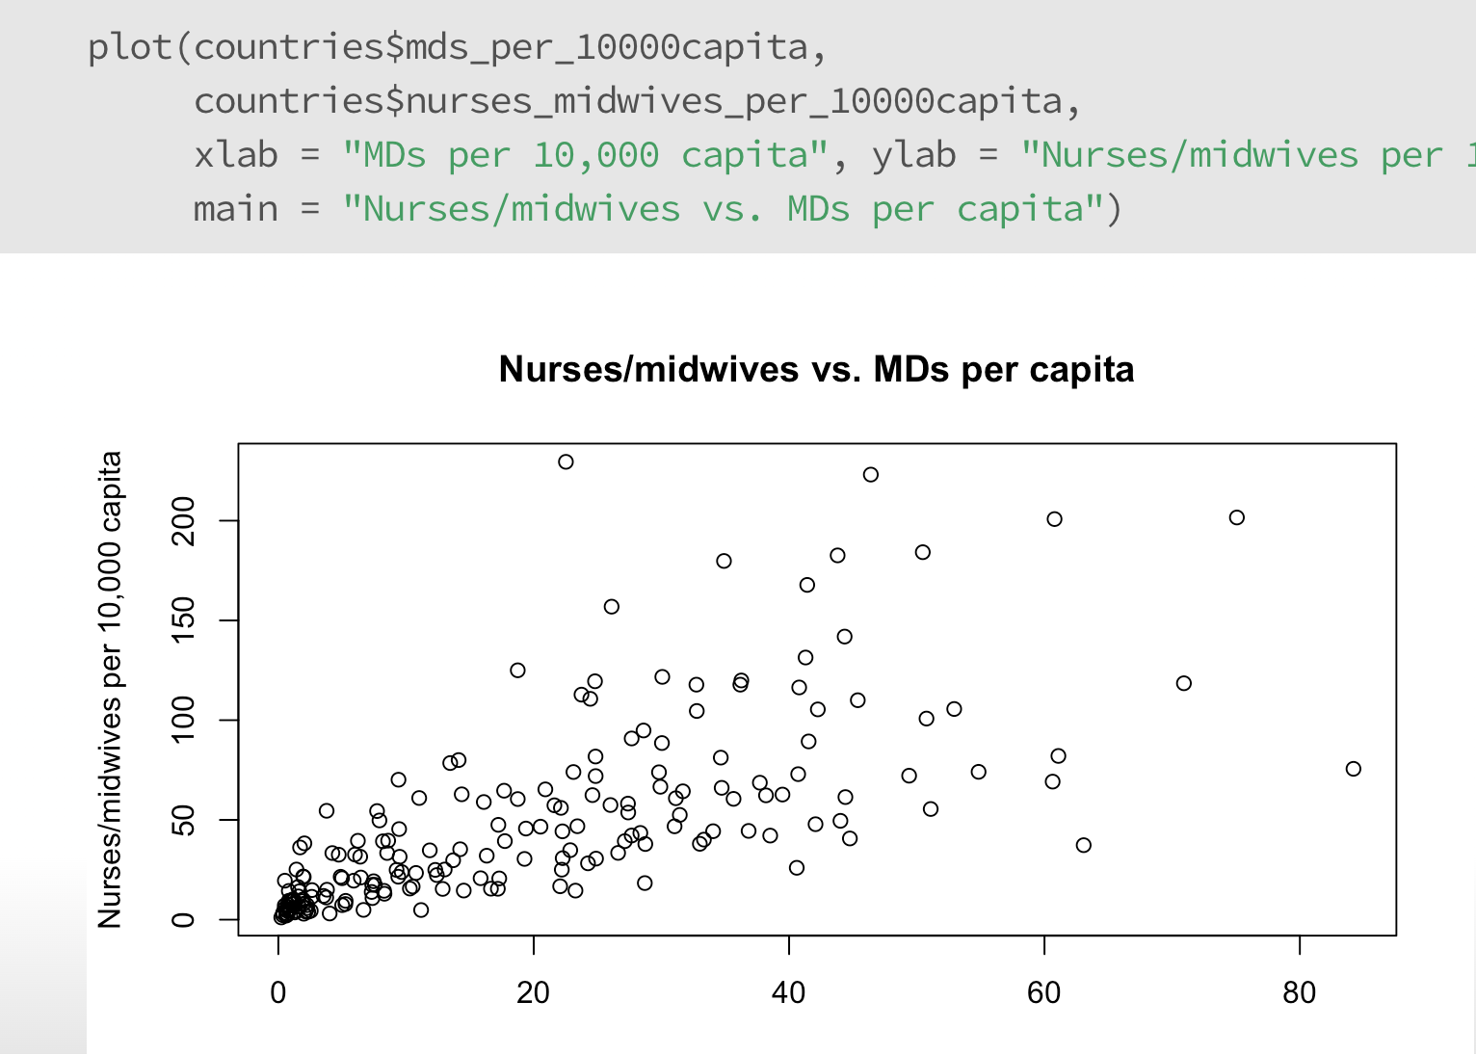
Basic plots in R
scatterplot

Slide 16
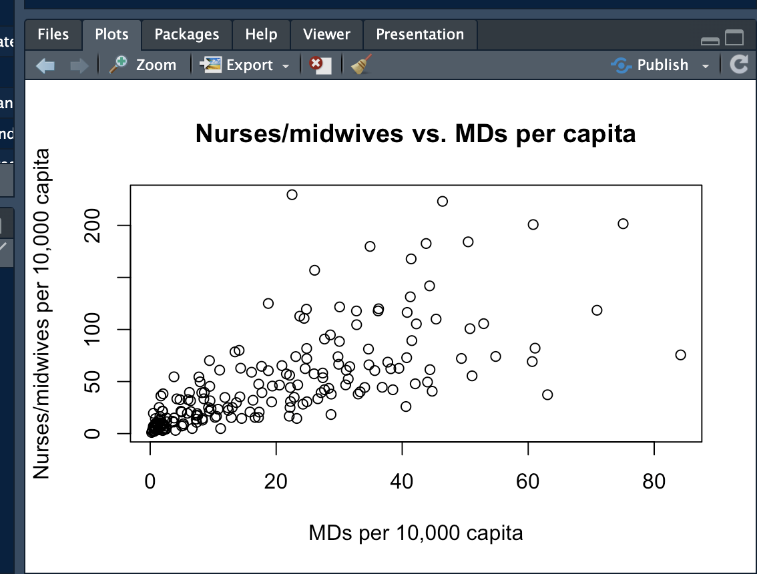
Exporting plots from RStudio

Slide 17
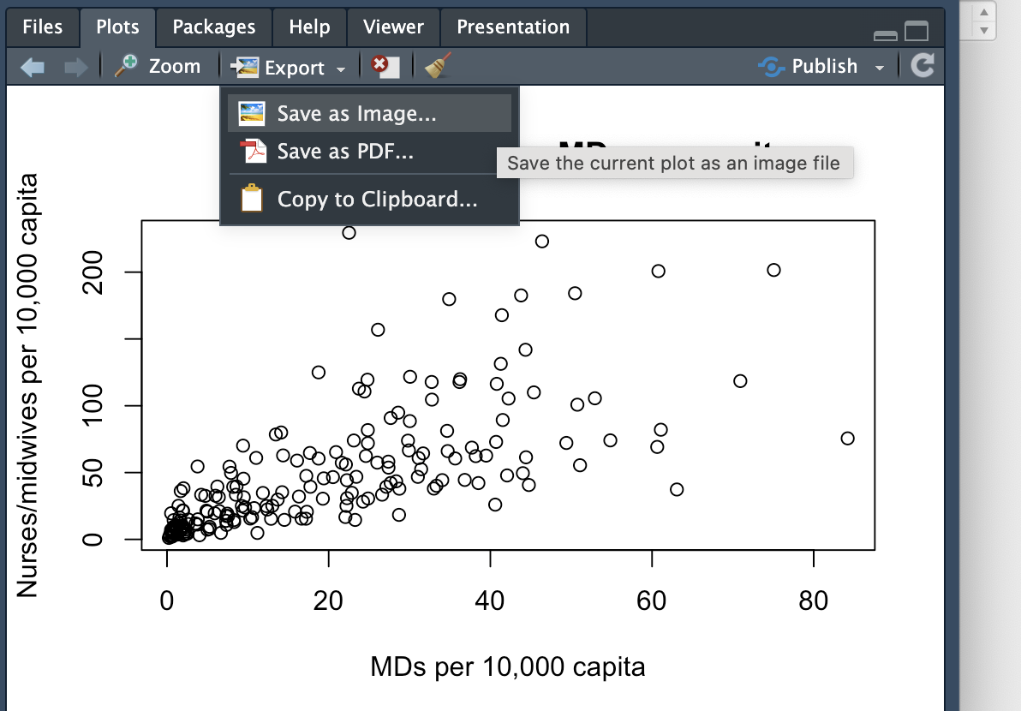
Exporting plots from RStudio

Slide 18
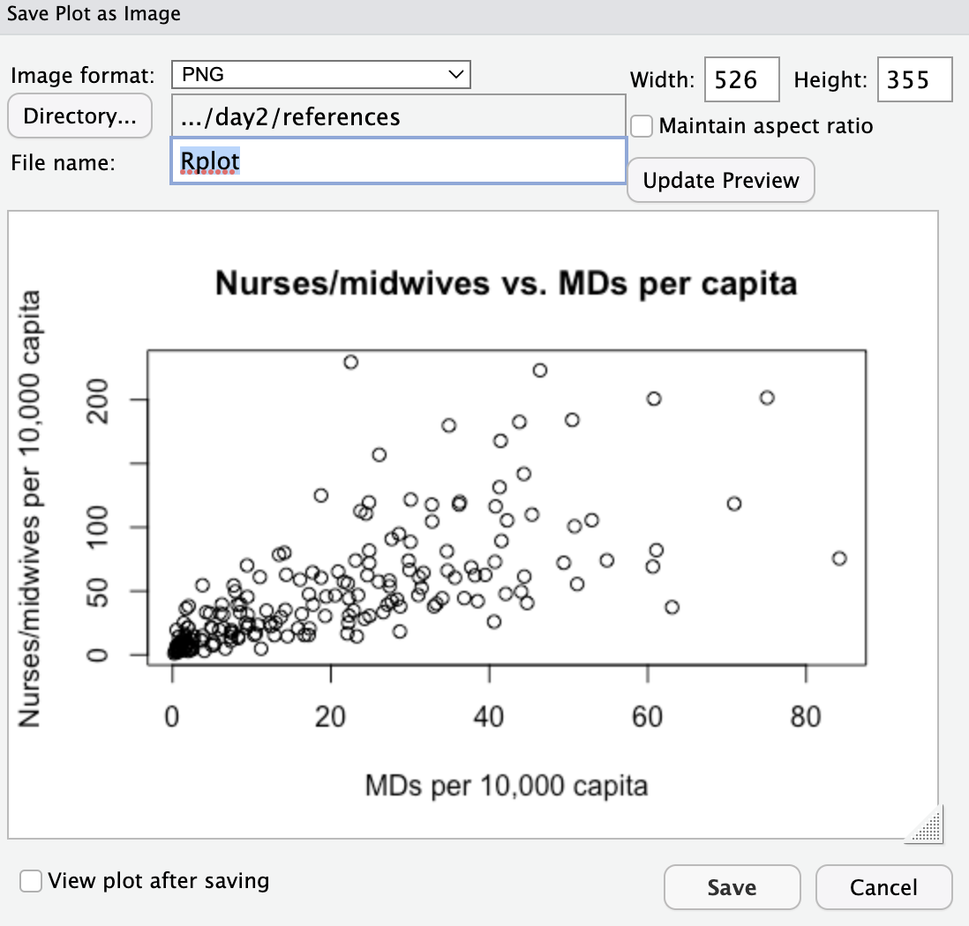
Exporting plots from RStudio
Name your file

Slide 19
Exporting plots from RStudio
Specify where you want to save the file

Slide 20
Exporting plots from RStudio
Adjust dimensions

Slide 21
Exporting plots from RStudio
Save to your computer

Slide 22
Now you try!
Make a histogram or barchart using the countries dataset
Save it to your computer

Slide 23
Fun with ggplot2

Slide 24
What is ggplot2?
ggplot2 is a plotting library in R
It’s a bit challenging to get the hang of at first, but it’s incredibly powerful and popular

Slide 25
Packages and libraries
Packages (like ggplot2) are sets of functions and data that can be loaded for specialized projects
The first time you use them, you need to install them: install.packages(”ggplot2”)
The next time you use them, you can just load them from your R library: library(“ggplot2”)

Slide 26
Now you try!
install.package(”ggplot2”)
Try installing ggplot2 on your computer

Slide 27
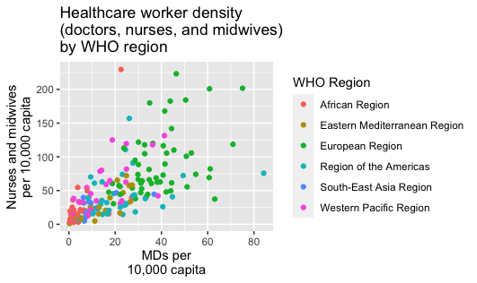
Using ggplot
scatterplot with groups

Slide 28
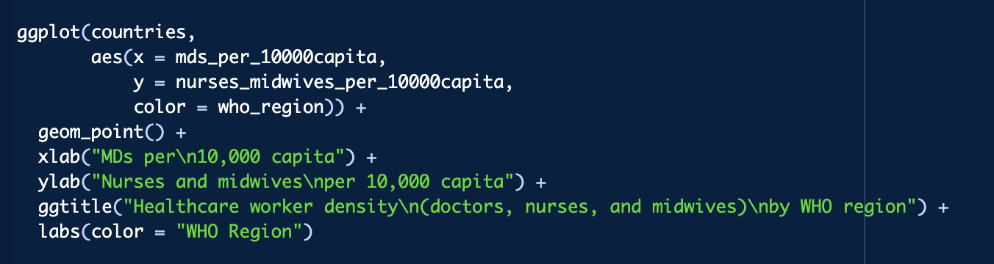
Using ggplot
scatterplot with groups

Slide 29
Using ggplot
scatterplot with groups
Dataset name

Slide 30
Using ggplot
scatterplot with groups
X and Y axes

Slide 31
Using ggplot
scatterplot with groups
Color the dots based on WHO region

Slide 32
Using ggplot
scatterplot with groups
Make a scatterplot

Slide 33
Using ggplot
scatterplot with groups
Specify axis and legend titles

Slide 34
Thank you!
See you tomorrow.
Please come with a fully charged laptop.
Lecture and course material adapted from Intro to R materials created by Alex Douglas, available online here, with corresponding free online textbook.

